Slide 1


Interactive Model of a Quantum Computer
@ Fascinating Informatics by SJF, September 2021
15.11.2021
Matias Betschen & Tommaso Peduzzi
Supervised by:
Valentin Bamert and Henrique Säuberli
Notes:
As in the opening slide, the acknoledgements are suitable for pictures or jokes which do not belong to the main part.

Slide 2
Our Experience
Task was given, but we were free to elaborate on it
Got a small intro into QC at the beginning of the week
Normally in Altstetten, at the end of the week went to the lab
All in all really enjoyable experience!

Slide 3
Our task
Create an interactable experience that gives a short introduction into quantum computing by explaining the different parts making up a quantum computer.
Notes:
Here discuss that we don‘t really want to explain quantum (computing) principles to the user, but to explain them what actually makes up a quantum computer.

Slide 4
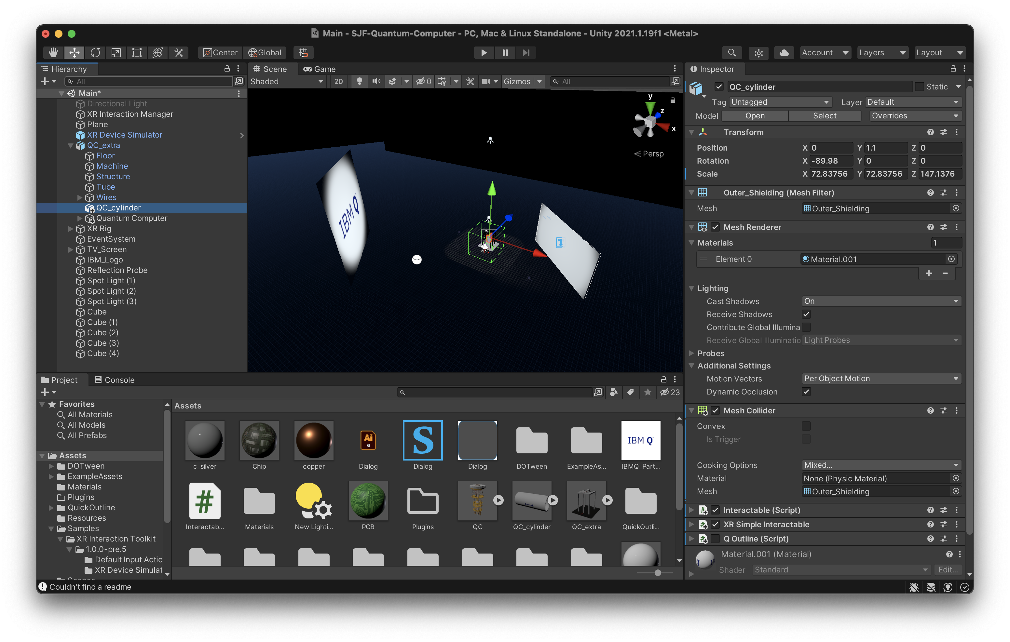
Our workflow
Tools:
Unity
Blender
HTC Vive
Went to the lab at the end of the week
Weren‘t able to finish completely
Notes:
Maybe mention that we were given some ressources and that the tutors helped us. Also tell them that we were only able to test it out on real hardware in the lab at the end of the week.

Slide 5
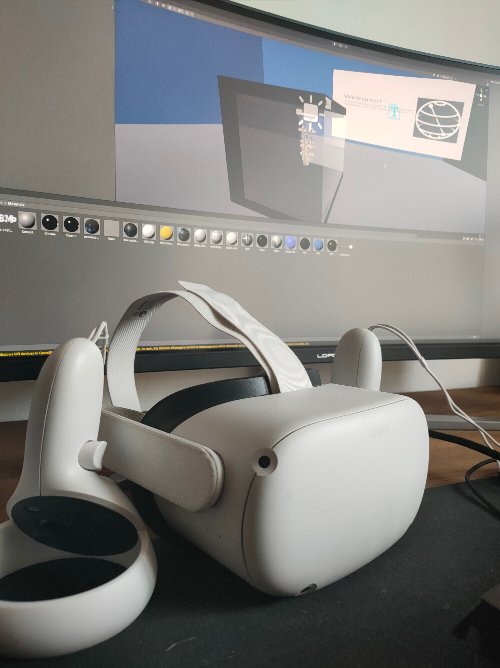
Further Development
Bought our own VR-Headsets
Added movement
New Model
Better lighting
Better information

Slide 6
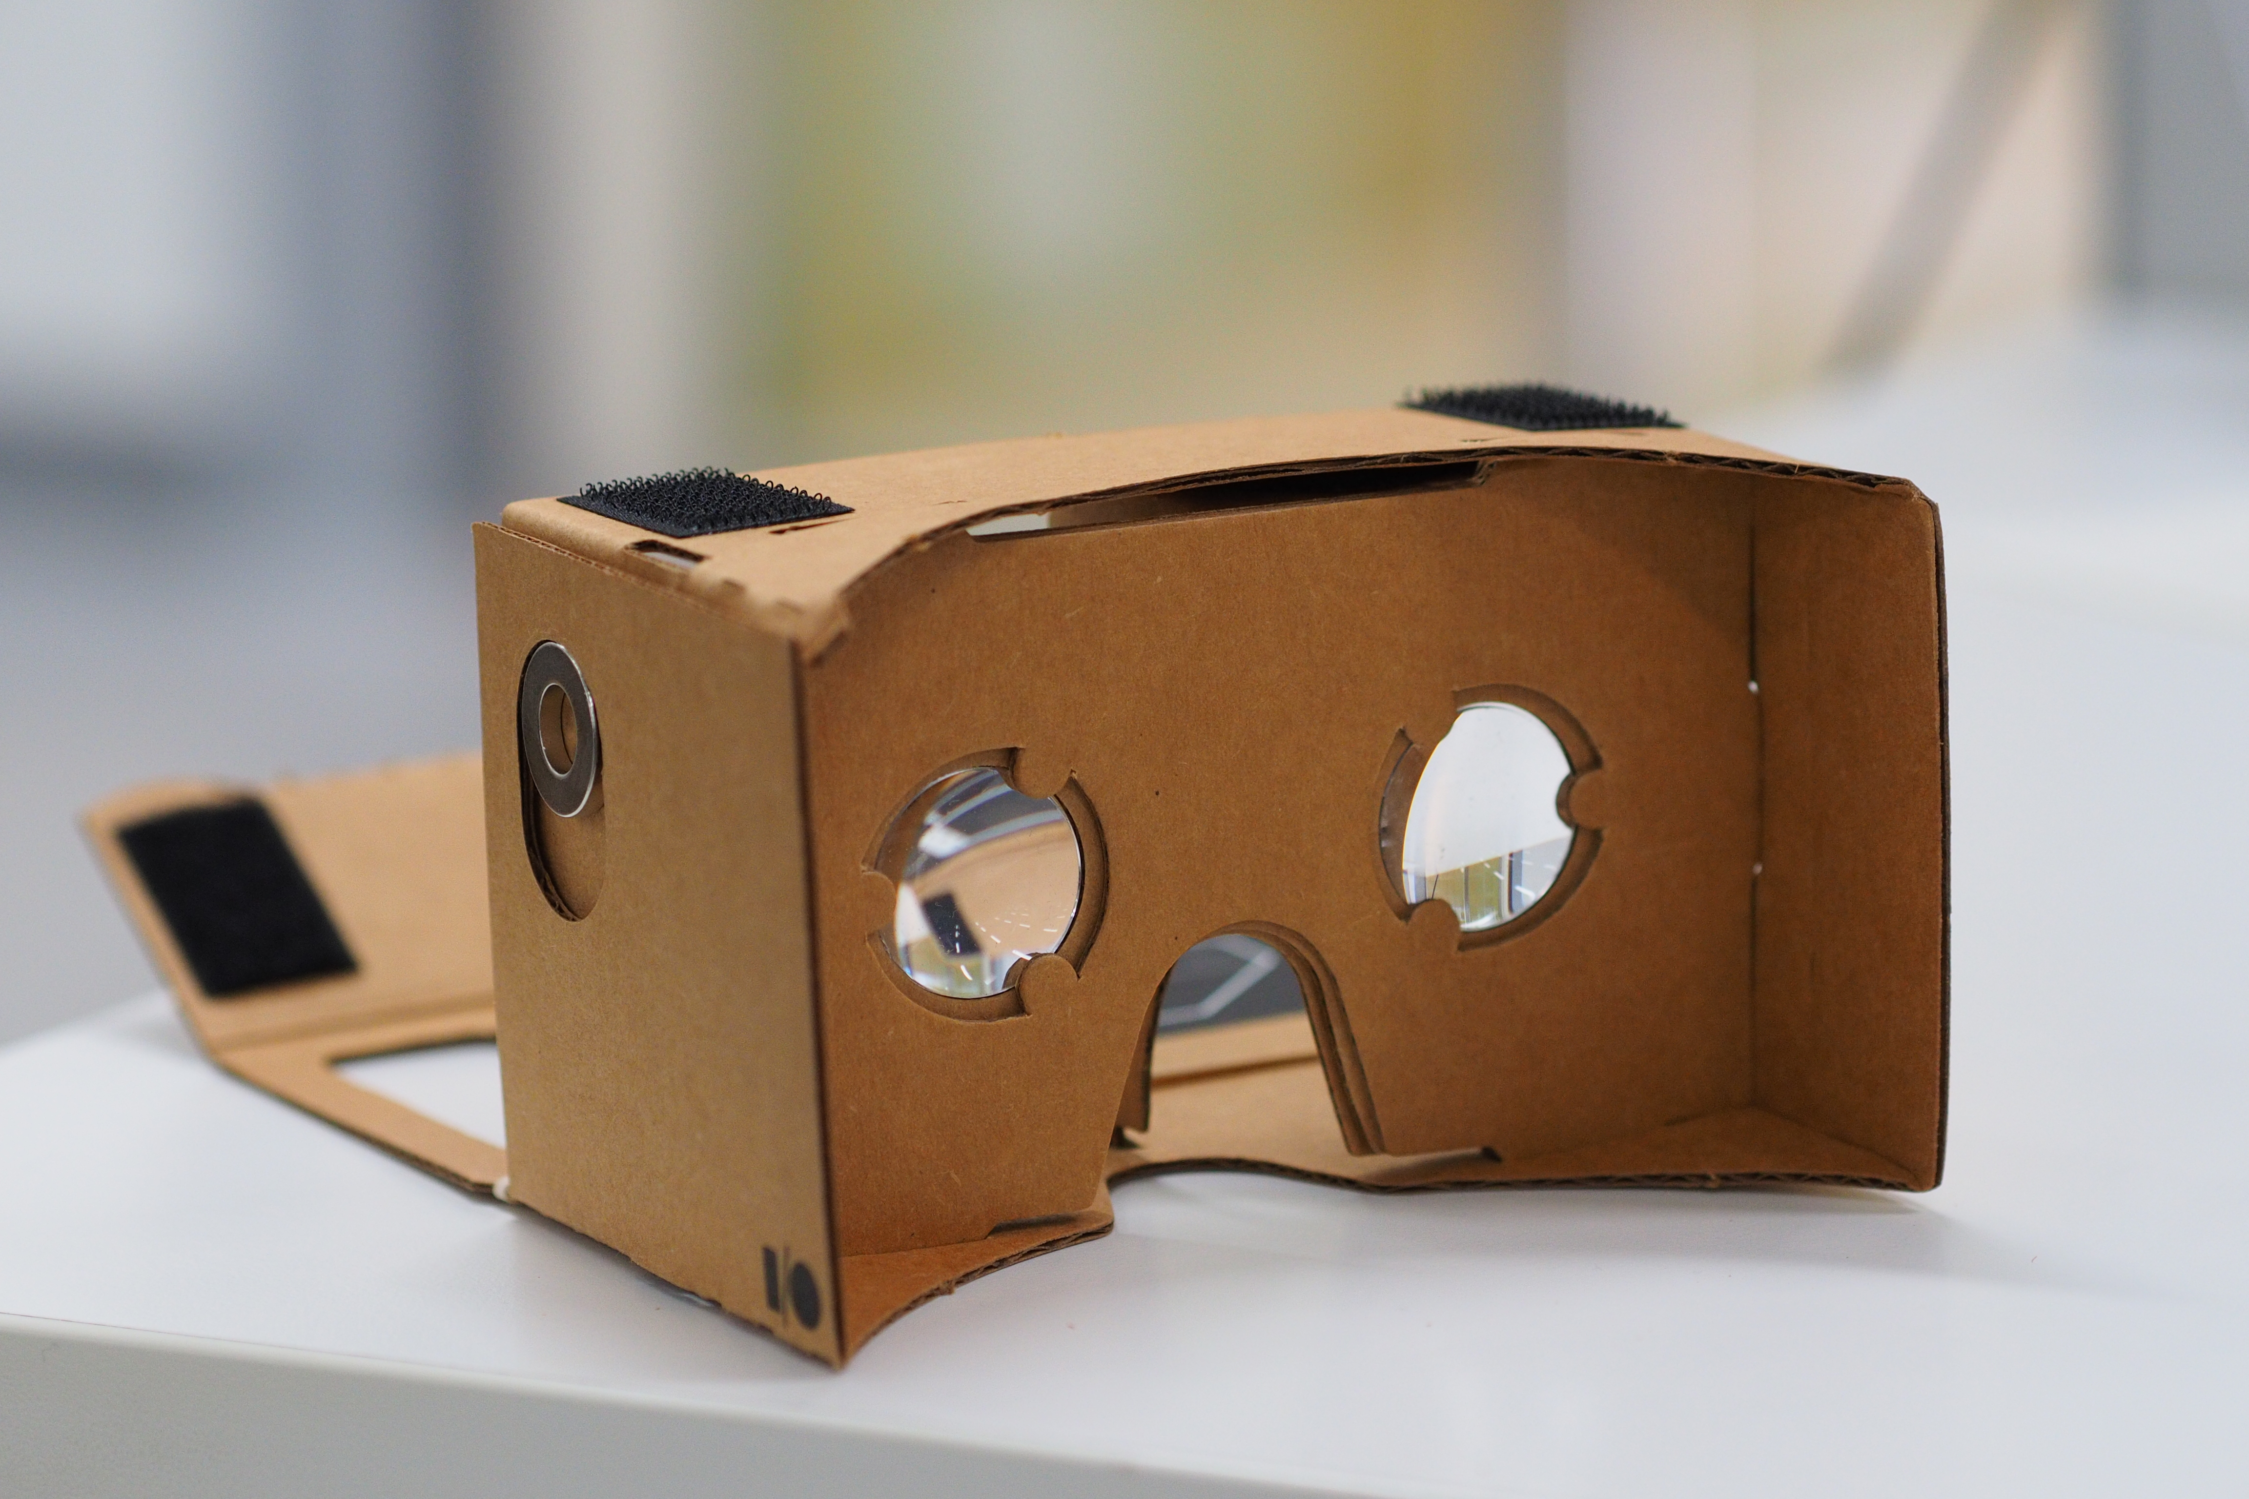
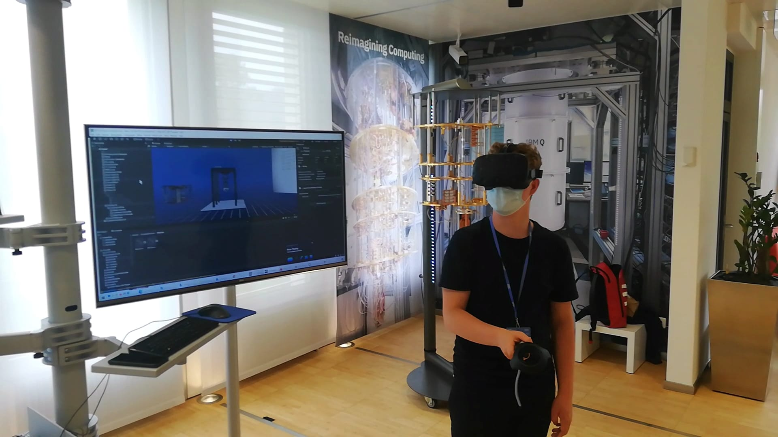
Closing Thoughts
Gives Clients an easy, but important insight into quantum computers
Easy to use and intuitive
Make it more accesible
e.g. Google Cardboard

Slide 7
Acknowledgements
Thanks to Schweizer Jugend Forscht and Valentin Bamer from IBM for the organization.
Thanks to Henrique Säuberli, Nadim Ritter, Radu Stingaciu and Calvin Limat for the tutoring!
Thanks to the IBM Research Lab for hosting our presentatio

